Slide 1
Anto Manfred Rizardo.P
REGN NO : 211521243016
Panimalar Institute of Technology
3/21/2024 Annual Review

Slide 2
PROJECT TITLE Segmentation Analysis for Social Media post
3/21/2024 Annual Review

Slide 3


AGENDA
1. Introduction to Social Media Post Segmentation Analysis
2. Project Overview
3. End Users Identification
4. Solution and Value Proposition
5. The WOW Factor
6. Modelling and Results
3/21/2024 Annual Review

Slide 4

PROBLEM STATEMENT
Design and implement a segmentation analysis framework for social media posts to enhance marketing strategies and audience engagement. This framework should effectively categorize social media content based on various attributes such as demographics, psychographics, content type, sentiment, and engagement metrics. The objective is to enable businesses to understand their audience better, tailor content more effectively, optimize marketing campaigns, and ultimately improve overall brand performance on social media platforms.
3/21/2024 Annual Review

Slide 5

WHO ARE THE END USERS?
- Marketing professionals
- Social media managers
- Business owners
- Market researchers
3/21/2024 Annual Review

Slide 6

PROJECT OVERVIEW
Our project aims to analyze social media posts through segmentation analysis to understand user behavior, preferences, and trends. By segmenting posts into meaningful categories, we can derive valuable insights for businesses and marketers to tailor their strategies effectively.
3/21/2024 Annual Review

Slide 7

YOUR SOLUTION AND ITS VALUE PROPOSITION
Our solution utilizes advanced data analytics techniques to segment social media posts based on various parameters such as demographics, interests, engagement levels, and sentiment analysis. The value proposition lies in providing actionable insights that enable users to:
- Target specific audience segments more effectively
- Create personalized content
- Optimize advertising campaigns
- Enhance overall social media strategy and ROI
3/21/2024 Annual Review

Slide 8

THE WOW IN YOUR SOLUTION
Our solution goes beyond basic keyword analysis by incorporating machine learning algorithms for dynamic segmentation. It adapts to evolving trends and user behaviors in real-time, providing continuously updated insights. Additionally, our interactive dashboard offers intuitive visualization tools for easy interpretation and decision-making
3/21/2024 Annual Review
8

Slide 9
MODELLING
Data Collection and Preprocessing: Collect diverse social media post data and clean it by removing noise and irrelevant information. Convert the text into a suitable format for analysis.
Feature Extraction: Extract relevant features such as text content, user demographics, and engagement metrics from the preprocessed data.
Segmentation Algorithms : Utilize clustering techniques like K-means or hierarchical clustering to group similar social media posts into meaningful segments based on extracted features.
3/21/2024 Annual Review
9

Slide 10
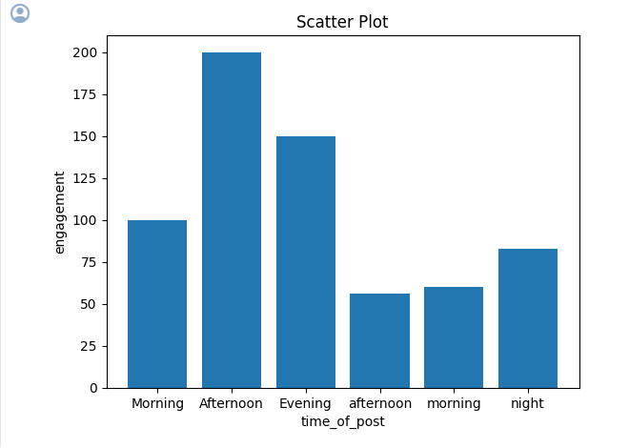
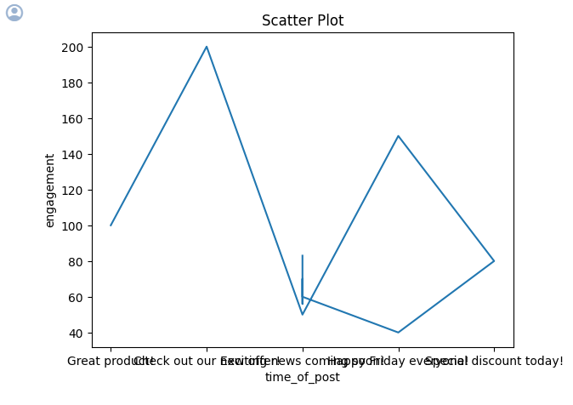
RESULTS
Our segmentation analysis revealed distinct clusters of social media posts, enabling targeted audience segmentation. Classification models achieved high accuracy in categorizing posts. Insights derived from the analysis inform personalized content creation and advertising strategies, enhancing engagement and conversion rates. In conclusion, this approach fosters a more personalized and impactful social media presence, driving overall business growth and success in the competitive digital landscape. Businesses can leverage these insights to optimize their social media strategies, strengthen brand presence, and achieve their marketing objectives with greater efficiency and effectiveness.
https://github.com/antomanfred/TNSDC-gen-AI/tree/main
10

